Slide 1
How to create a report of all active electronic collections in the institution
Yoel Kortick
Senior Librarian

Slide 2

Agenda
Introduction
Creating the report
Checking the results

Slide 3
Introduction

Slide 4
Introduction
In the example here we will create a report of "All active electronic collections in the institution"
We will get the "Active" collections by filtering by the "number of available portfolios" per collection "is greater than or equal to one".
Thus, every collection in the report will have at least one active portfolio.
Checking these electronic collections in Alma shows that they all are active (blue icon and not grey icon next to the repository search results)

Slide 5
Creating the report

Slide 6
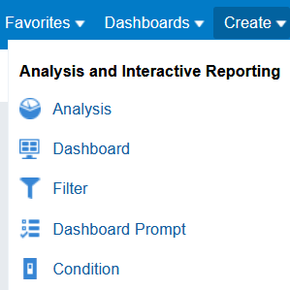
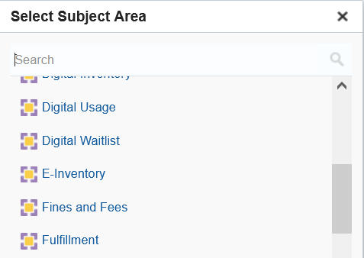
Creating the report
Create a new analysis in the E-Inventory subject area

Slide 7
Creating the report
Display the following fields:
"Electronic Collection Id" (from "Electronic Collection" folder)
"Electronic Collection Public Name"(from "Electronic Collection" folder)
"Electronic Collection Linked To CZ" (from "Electronic Collection" folder)
"No. of Available Portfolio" (from "Portfolio" folder)

Slide 8
Creating the report
Filter by the following fields:
"Electronic Collection Lifecycle" (in the "Electronic Collection" folder) = 'In Repository'
"No. of Available Portfolio" (from Portfolio folder) is greater than or equal to 1
Optionally Filter by
"Electronic Collection Linked To CZ" (in the "Electronic Collection" folder) = 'In Repository'.

Slide 9
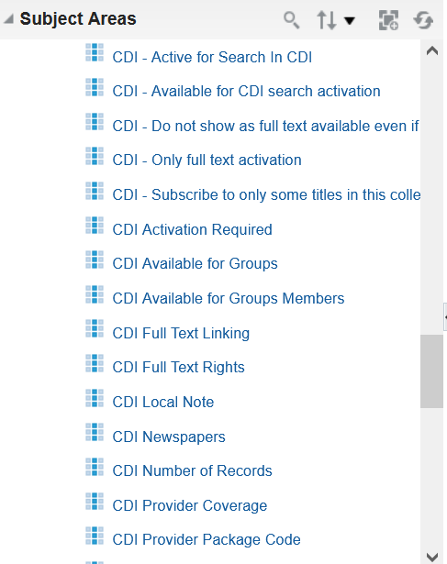
Creating the report
Depending on the purpose of the report you may want to also display and / or filter by the CDI fields in the "Electronic Collection" folder.

Slide 10
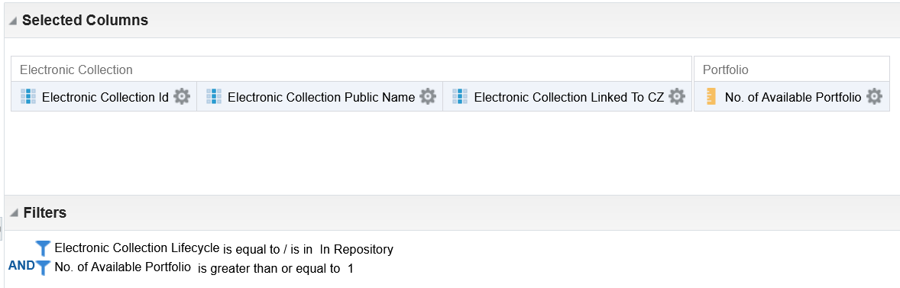
Creating the report
Here is the criteria tab of the report

Slide 11
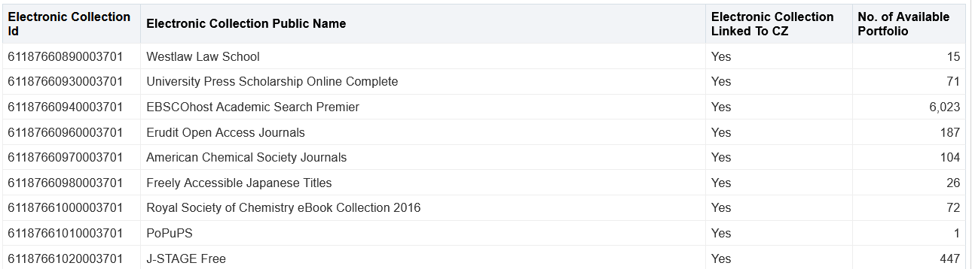
Creating the report
Here are the (partial) results

Slide 12
Checking the results

Slide 13
Checking the results
Let's check the first three results and make sure they are active in Alma.
We see that they are active, based on the blue icon in the repository search results.

Slide 14
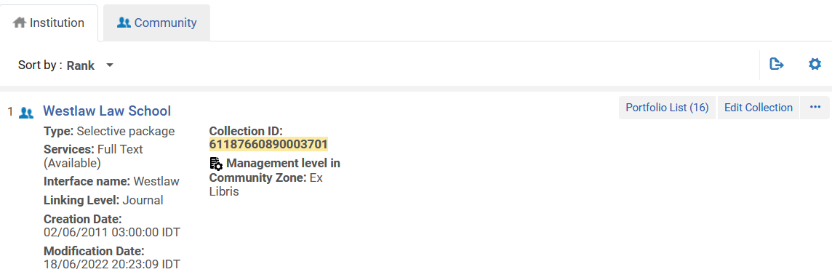
Checking the results

Slide 15
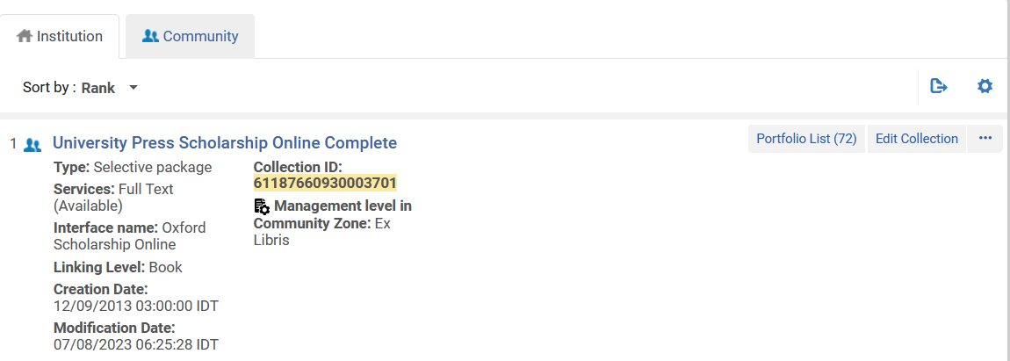
Checking the results

Slide 16
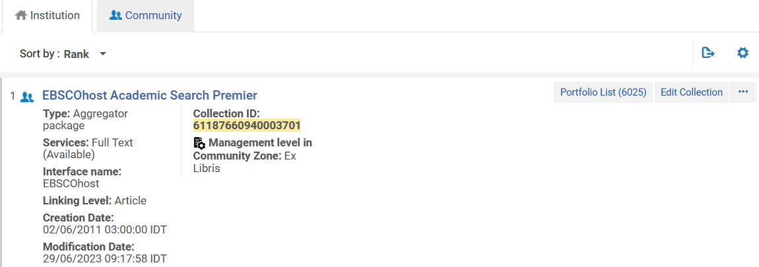
Checking the results

